Slide 1


LASAGNE digitaL frAmework for SmArt Grid and reNewable Energies WP3 : Coordination platform and digital twins
ERA-NET 108767
SFOE 810008657
Giovanna Di Marzo Serugendo
Philippe Glass

Slide 2


WP3 – Objectives / Deliverables / Milestones
WP3 Objectives
Developing a digital framework for collaborative learning among GEDs.
Developing a collaborative ML approach among the different data sources and computational units.
To address this problem, we use a coordination model that provides a coordination media and mechanisms, allowing the GEDs (via intelligent digital twins) to exchange information, about production/consumption, and to collectively and in a decentralised manner smoothly reach varied objectives linked to context-aware/self-adaptive applications.
WP3 Aim
Defining collaborative, distributed ML algorithms providing robust predictions of power usage/production. They rely on coordination middleware and intelligent digital twins providing support for distributed interactions specific to smart grids.

Slide 3
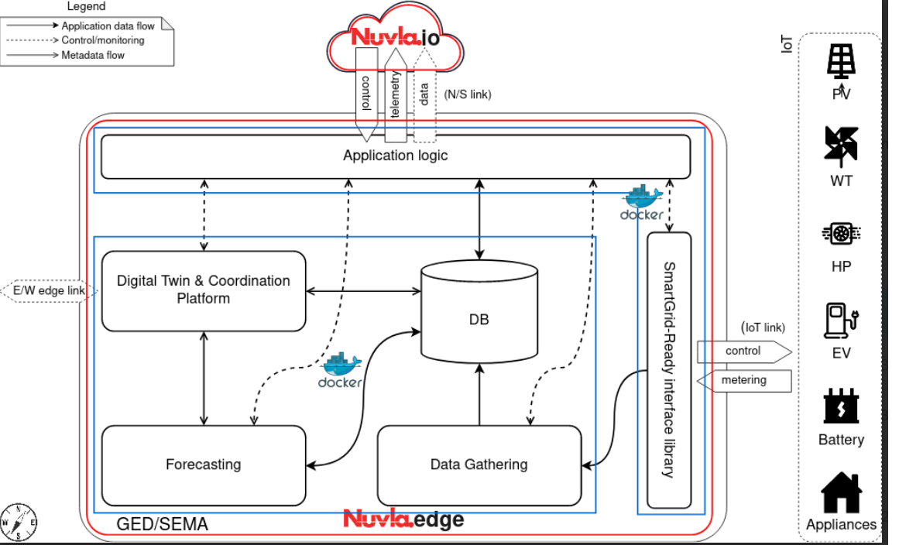
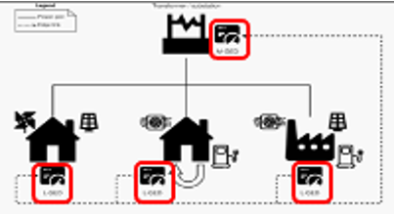
WP3 – Objectives / Deliverables / Milestones
Deliverables
D3.1: Design of distributed collaborative learning methods
D3.2: Coordination model and middleware extended with distributed algorithms and mechanisms specific to smart grids. Design of digital twins.
D3.3: Implementation of distributed collaborative learning. Implementation of intelligent digital twins.
Milestones
M2: Coordination model, digital twins and design of distributed collaborative ML methods are implemented on an experimental edge-to-cloud architecture → submitted

Slide 4

WP3 - Status - DONE
Coordination model and platform
Available and running
Uses real data from Les Vergers
Digital twins (producer, consumer, regulator, learning agent)
Available and running, interacting through the coordination platform
Algorithms - energy :
Energy contracts (wattage, no pricing) among producers, consumers
Peak shaving among producers, consumers, regulator
Algorithms - learning:
Gossip-based learning through platform (done for Markov chain learning model)
De-Centralised federated learning (outside coordination platform – HEPIA)
Interactions among multiple platforms
One node
Multiple node (four) in P2P fashion

Slide 5
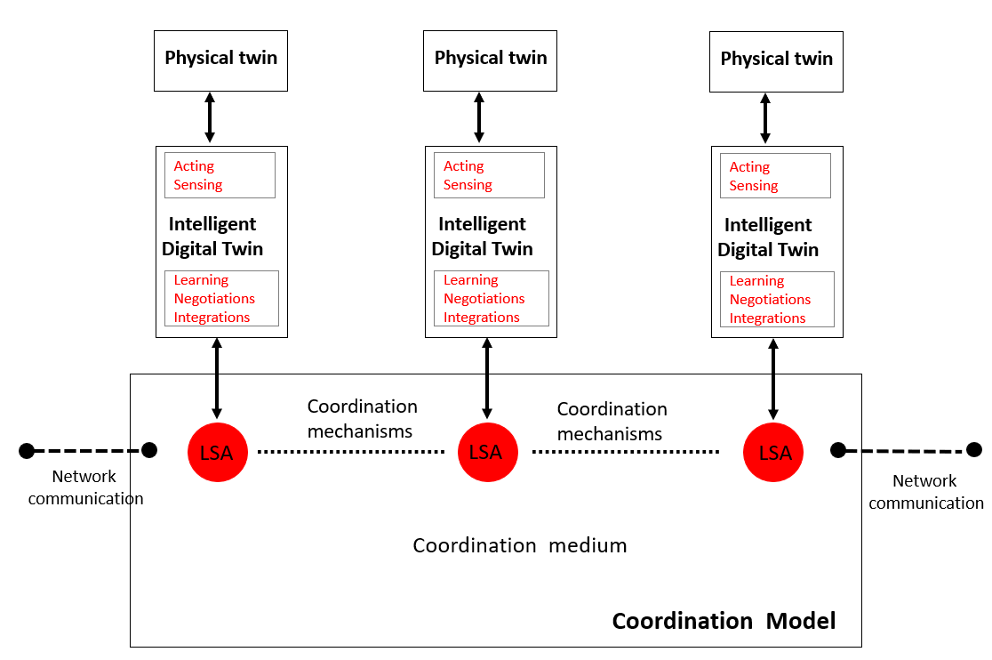
Coordination model and platform
Implementation of a coordination platform using:
digital twins,
shared virtual environment (tuple space)
coordination laws.
Sierre,June 8 2023

Slide 6
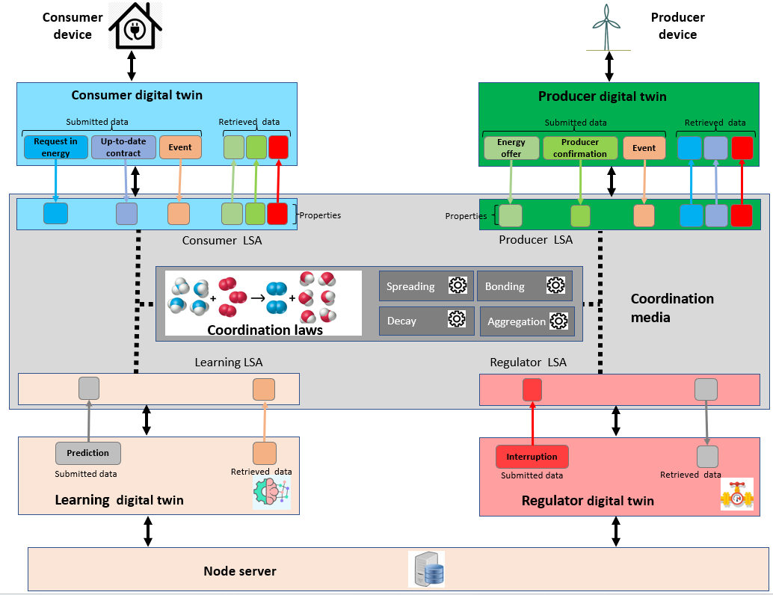
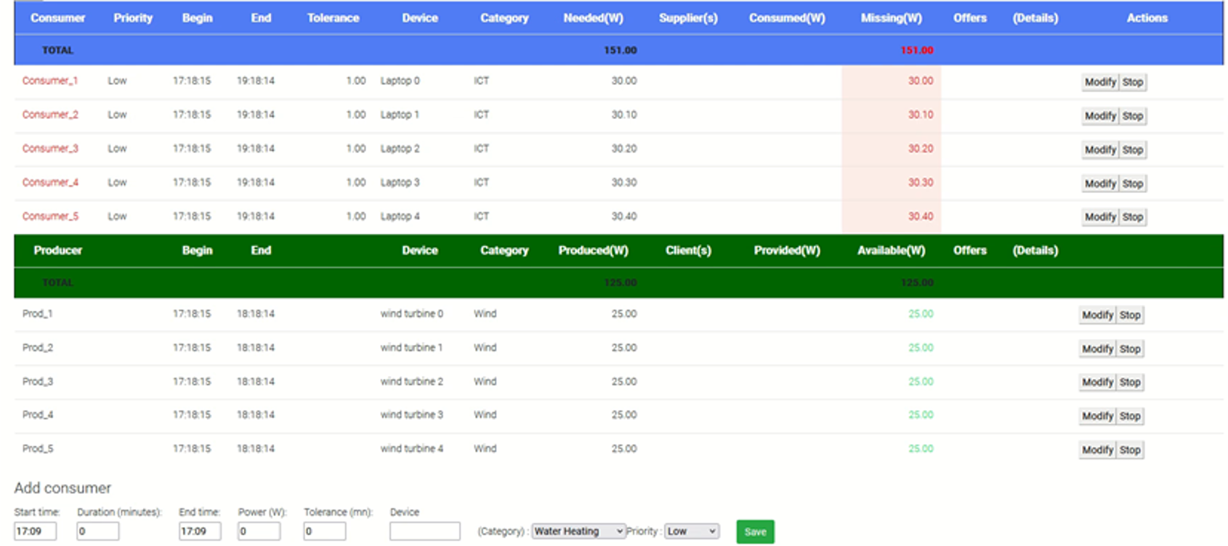
Coordination platform and digital twins
Digital twins : agents' behaviors as
consumer
producer,
learning agent
regulator
Agents act autonomously, adapt, organize and make decisions according to the situation.
Dynamic self-adaptive generation of supply contracts between producers and consumers
Sierre,June 8 2023

Slide 7
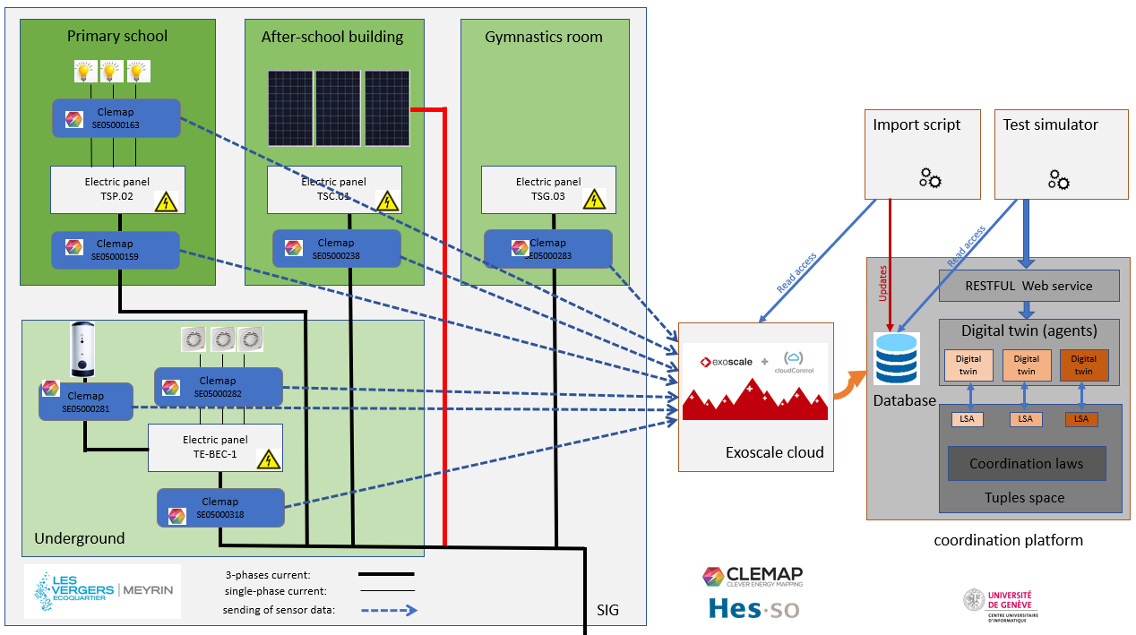
Use of real data from the "Les Vergers" living-lab
Measurement data from “Les Vergers”
Sierre,June 8 2023

Slide 8
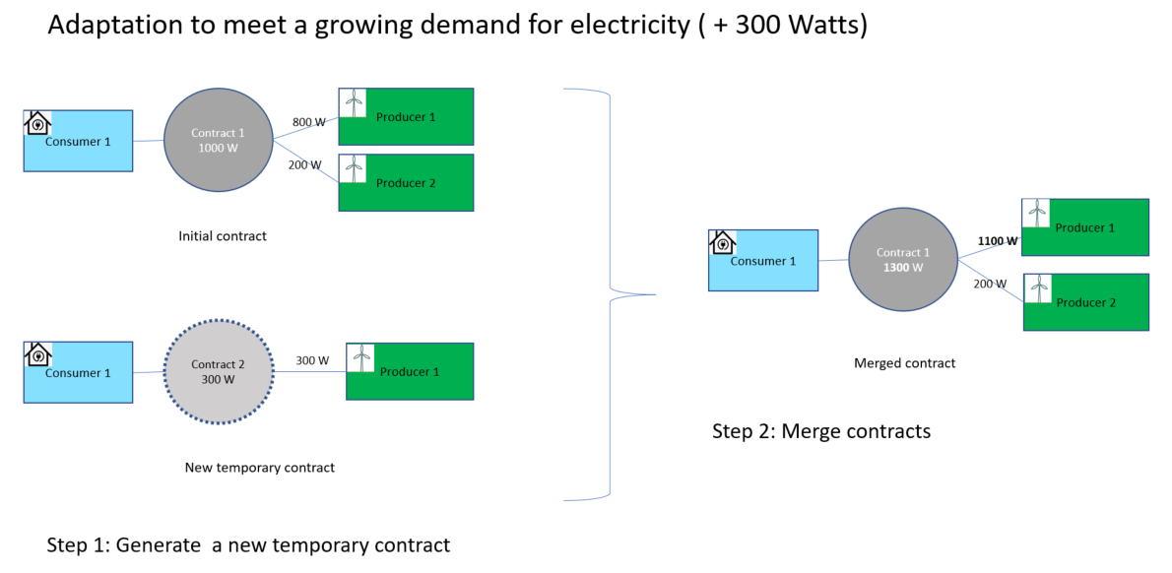
Adaptation of the digital twins
Testing of the consumer/producer digital twins by using the data collected from Les Vergers.
Customization of the digital twins to fit better with real-world situations:
Adaptation of the prediction states to fit with the used powers
Consideration of fluctuation in demand so as not to break a contract after each power change:
Use of a margin in a contract to absorb the power variation
Use of a second « transition contract » when the variation is more important.
Sierre,June 8 2023

Slide 9

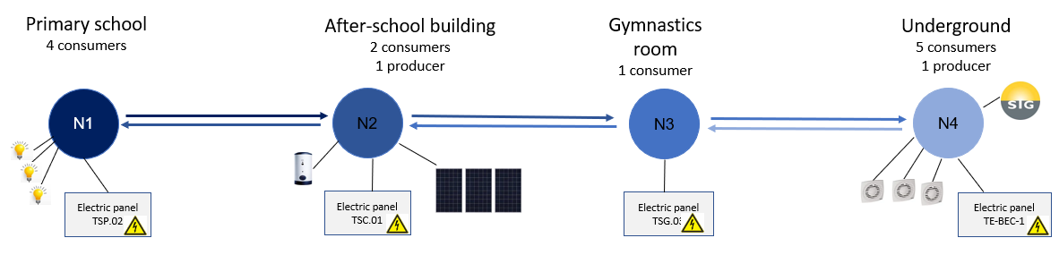
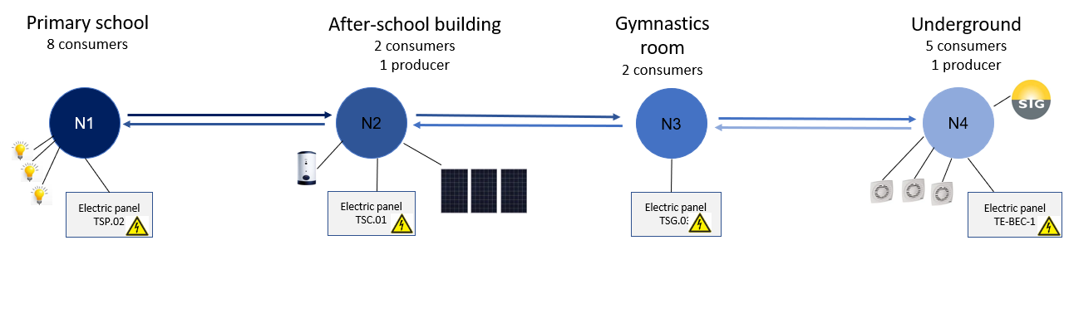
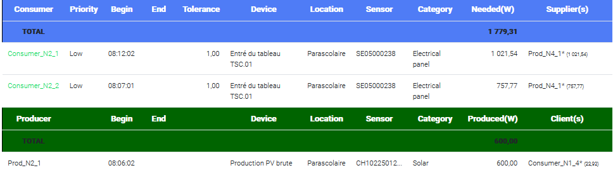
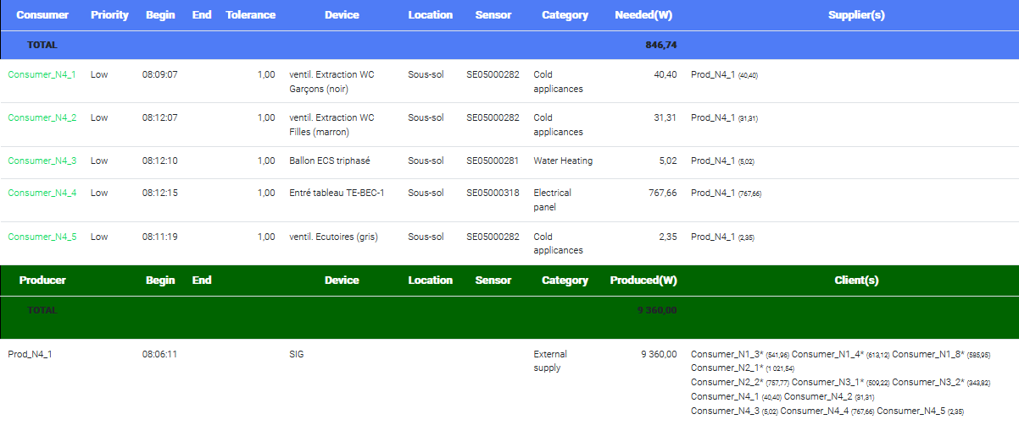
Coordination Platform tuning in a 4-nodes configuration
“Chain” configuration (1 or 2 neighbors by node)
Sierre,June 8 2023

Slide 10

WP3 - Status - ONGOING
Light infrastructure and Integration into CLEMAP GED
Ongoing
Gossip-based federated learning
Experimentation with the model of Markov Chains, executed on 4 nodes
TODO: Generalise to any learning model
P2P interactions / Interactions among multiple platforms
Generalisation from 4 nodes to any number, any topology

Slide 11
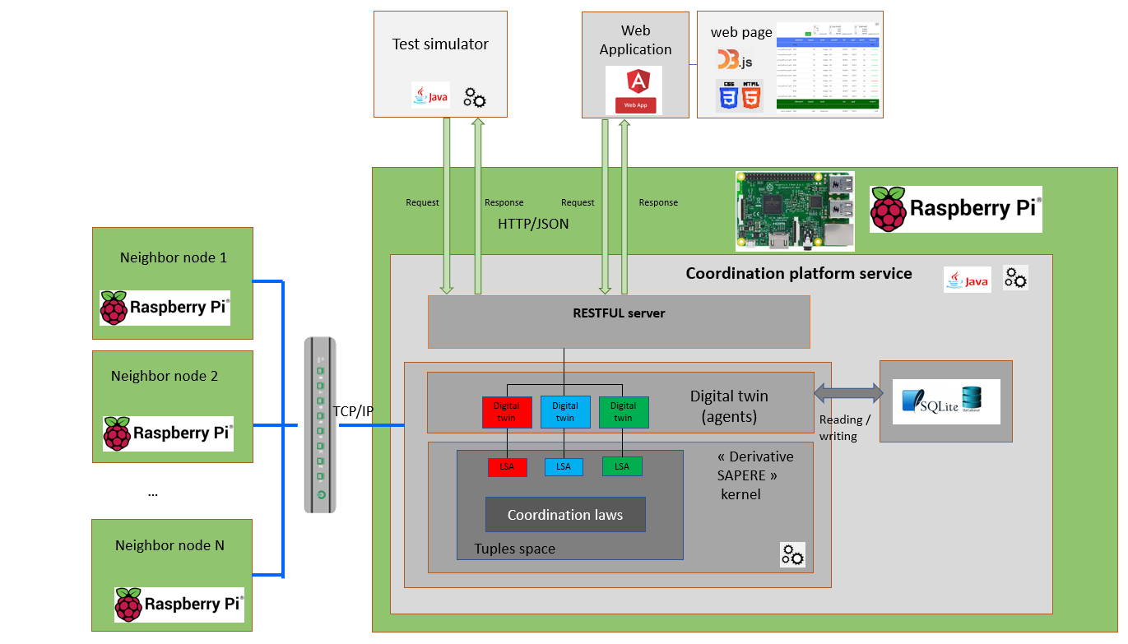
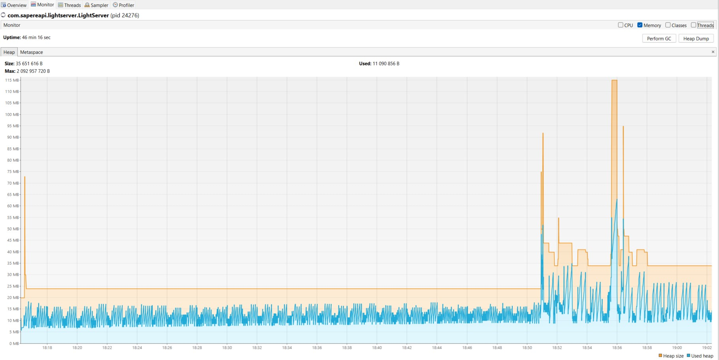


Preparation of a light version for Raspberry pi-3
Definition of the target environment
Replacement of spring-boot server by a lighter server
Deactivation of functionalities not used (prediction)
Monitoring of memory consumption (use of Visual VM tool)
Replacement of MariaDB & MongoDB by SQLite3
Building of docker image containing the coordination service jar file
Deployment and tests on Linux environment (UNIGE VM)
Sierre,June 8 2023

Slide 12
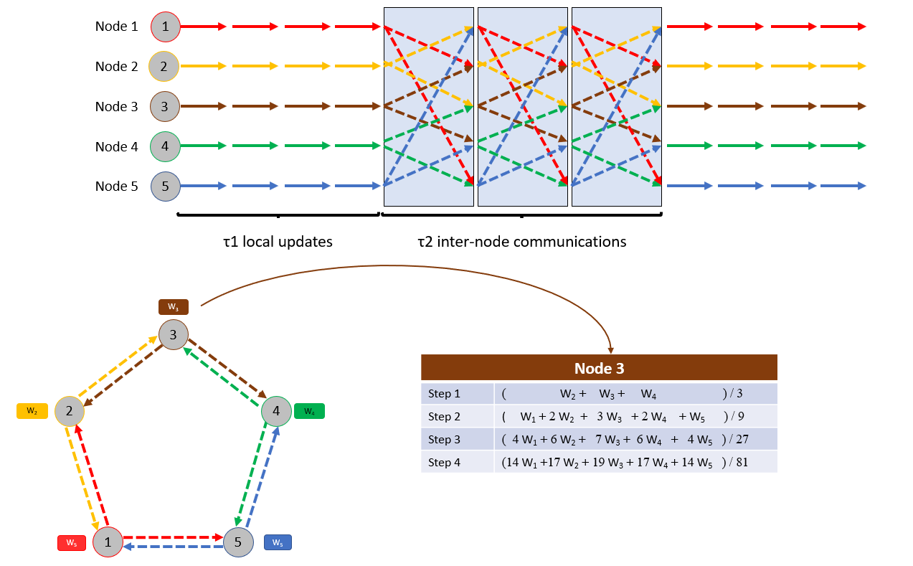
Decentralized Federated Learning by using the platform
Use of machine learning at each node level
Fully decentralized
Exchange of model data between nodes
Aggregation of model weights at each node (progressive aggregation)
=> Advantages:
network traffic reduced between nodes.
confidential data not shared.
Wei Liu, Li Chen, and Wenyi Zhang :
Decentralized Federated Learning: Balancing Communication and Computing Costs
Sierre,June 8 2023

Slide 13
Gossip-Based Decentralised Federated Learning with coordination platform
aggregation + spreading => Gossip
Preliminary experiments with Markov chain
Learning agent
Learning agent
Tuples space
Tuples space
LSA
LSA
LSAext
LSAext
Eco-Laws
Eco-Laws
Bonding
❄
Bonding
❄
❄
Spreading
❄
Spreading
Decay
Decay
❄
❄
Aggregation
❄
Aggregation
❄
❄
❄
Gossip
Gossip
Sierre,June 8 2023

Slide 14

WP3 - Status (TODO)
Social acceptance by design (use of the WP2 project's findings)
Introduce the notion of fairness/equity, and considerer it in the algorithms of negotiation and contract generation
Introduce gamification =>get users more involved
Design a recovery plan in case of shortage => makes users feel more confident
Game theory based contracts
Mechanism of offers evaluation, based on several criterion related to personal/social welfare.
Mechanism of negotiation
for bilateral negotiations.
for multilateral negotiations in organised market (as Dutch auction)
Use the theory of Nash equilibrium to optimise the likelihood to succeed a negotiation
Use Electricity living-lab data?

Slide 15
Integration of social acceptance by design
Integration criterion based on social acceptance in the mechanism of contract negotiation :
=> sustainability, involvement-vs- free-riding, equity, environmental impact
Ensure protection of confidential data
Integration of a recovery plan in case of shortage or system attack
=> makes users feel more confident
Design gamification elements that take into account users' aspirations and psychological profiles
=> get users more involved
Sierre,June 8 2023
15

Slide 16
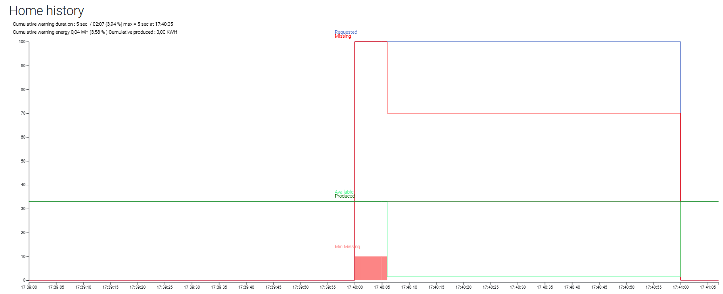
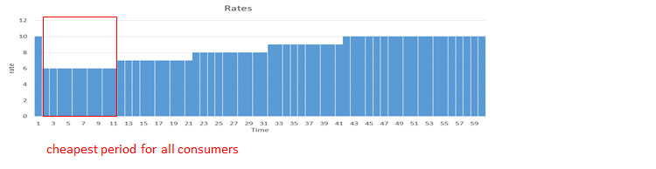
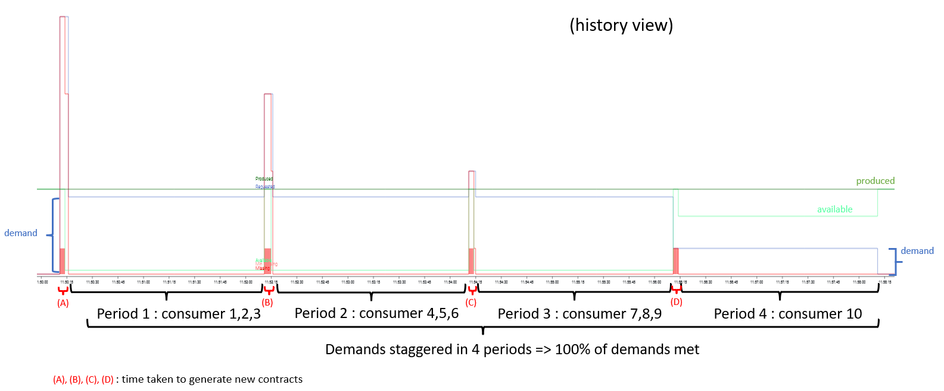
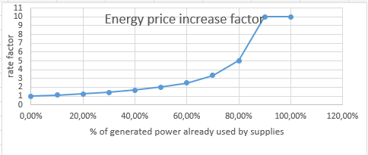
Strategy to deal with Tragedy of the commons
(Scenario “tragedy of the common”)
Without pricing policy
Shortage for 70 % of consumers
Use of pricing factor that increases with demand
Sierre,June 8 2023
staggering of requests

Slide 17
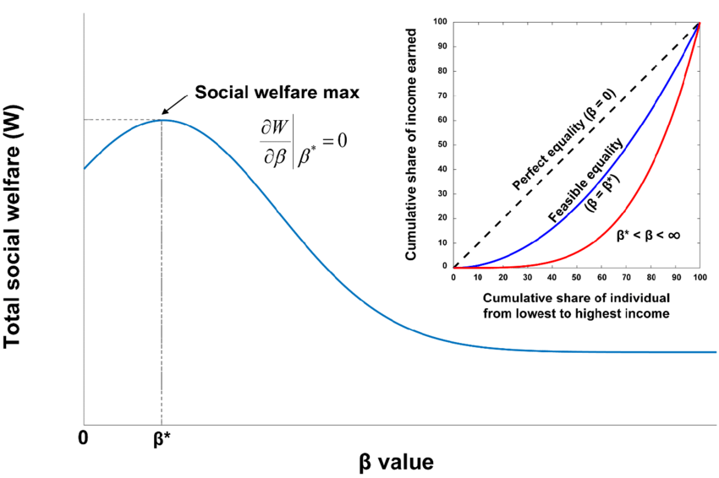

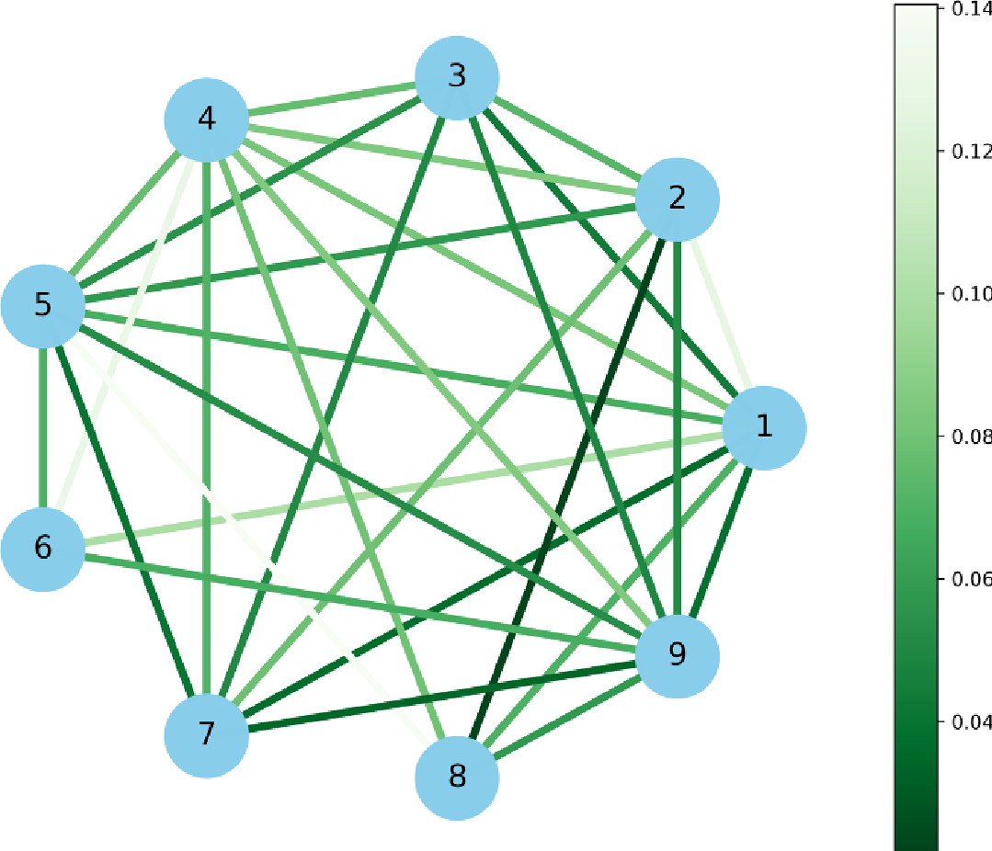
Strategy of negotiation (gaming, auctions, ..)
Mechanism of contract/negotiation by integrating welfare criterion
=> evaluate function for each criteria
Modeling of agent’s utility function
Agent #i : Profile = {λ¹_{i}, λ²_{i}, ….. , λ^{p}_{i}}
Offer: ω
utility: ω -> λ¹_{i}*e¹(ω) + … + λ^{p}_{i} * e^{p}(ω)
U_{i}(ω)
Modeling of bilateral negotiation
Modeling of multilateral negotiation : organized market (auctions)
Sierre,June 8 2023

